Slide 1
INCLUDING CONSTRAINTS
SQL
STRUCTURED QUERY LANGUAGE

Slide 2
Objectives
After completing this lesson, you should be able to do the following:
Describe constraints
Create and maintain constraints

Slide 3
What are Constraints?
You can use constraints to do the following:
Enforce rules on the data in a table whenever a row is inserted, updated, or deleted from that table. The constraints must be satisfied for the operation to succeed.
Prevent the deletion of a table if there are dependencies from other tables.

Slide 4
Data Integrity Constraints
Constraint | Description
NOT NULL | Specifies that the column cannot contain a null value
UNIQUE | Specifies a column or combination of columns whose values must be unique for all rows in the table
PRIMARY KEY | Uniquely identifies each row of the table
FOREIGN KEY | Establishes and enforces a foreign key relationship between the column and a column of the referenced table
CHECK | Specifies a condition that must be true

Slide 5
Constraint Guidelines
Name a constraint or the Oracle server generates a name by using the SYS_Cn format.
Create a constraint either:
  At the same time as the table is created, or
  After the table has been created
  Define a constraint at the column or table level.
  View a constraint in the data dictionary

Slide 6
Defining Constraints
CREATE TABLE [schema.]table
(column datatype [DEFAULT expr]
[column_constraint],
…
[table_constraint][,…]);
CREATE TABLE emp(
empno NUMBER(6),
ename VARCHAR2(20),
job VARCHAR2(20) NOT NULL,
CONSTRAINT emp_empno_pk PRIMARY KEY (empno));

Slide 7
Defining Constraints
Column constraint level
Table constraint level
Column [CONSTRAINT constraint_name] constraint_type,
Column,…
[CONSTRAINT constraint_name] constraint_type
(column, …),

Slide 8
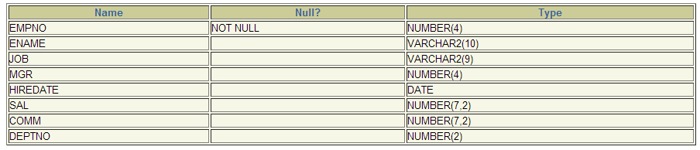
The NOT NULL Constraint
Ensures that null values are not permitted for the column:

Slide 9
The NOT NULL Constraint
Is defines at the column level:
CREATE TABLE emp(
empno NUMBER(6),
ename VARCHAR2(25) NOT NULL,
sal NUMBER(8,2),
comm NUMBER(2,2),
hiredate DATE
CONSTRAINT emp_hiredate_nn NOT NULL);

Slide 10
The UNIQUE Constraint
A unique key integrity constraint requires that every value in a column or set of columns (key) be unique – that is, no two rows of a table can have duplicate values in a specified column or set of columns.

Slide 11
The UNIQUE Constraint
Defined at either the table level or the column level:
CREATE TABLE emp(
empno NUMBER(6),
ename VARCHAR2(25) NOT NULL,
username VARCHAR2(25),
sal NUMBER(8,2),
comm NUMBER(2,2),
hiredate DATE NOT NULL,
…
CONSTRAINT emp_username_uk UNIQUE(email));

Slide 12
The PRIMARY KEY Constraint
A primary key constraint creates a primary key for the table. Only one primary key can be created for each table. The primary key constraint is a column that uniquely identifies each row in a table. This constraint enforces uniqueness of the column or column combination and ensures that no column that is part of the primary key contain a null value.

Slide 13
The PRIMARY KEY Constraint
Defined at either the table level or the column level:
CREATE TABLE dept(
deptno NUMBER(4),
dname VARCHAR2(30)
CONSTRAINT dept_dname_nn NOT NULL,
mgrno NUMBER(6),
loc NUMBER(4),
CONSTRAINT dept_deptno_pk PRIMARY KEY(deptno));

Slide 14
The FOREIGN KEY Constraint
The foreign key, or referential integrity constraint, designates a column or combination of columns as a foreign key and establishes a relationship between a primary key or a unique key in the same table or a different table.
A foreign key value must match an existing value in the parent table.
Foreign keys are based on data values and are purely logical, not physical, pointers.

Slide 15
The FOREIGN KEY Constraint
Defined at either the table level or the column level:
CREATE TABLE emp(
empno NUMBER(6),
lname VARCHAR2(30) NOT NULL,
email VARCHAR2(25),
salary NUMBER(8,2),
comm NUMBER(4,2),
hiredate DATE NOT NULL,
deptno NUMBER(4),
CONSTRAINT emp_deptno_fk FOREIGN KEY(deptno)
REFERENCES dept(deptno),
CONSTRAINT emp_email_uk UNIQUE(email));

Slide 16
The FOREIGN KEY Constraint
Keywords
FOREIGN KEY: defines the column in the child table at the table constraint level
REFERENCES: identifies the table and column in the parent table
ON DELETE CASCADE: deletes the dependent rows in the child table when a row in the parent table is deleted.
ON DELETE SET NULL: converts dependent foreign key values to null

Slide 17
The CHECK constraint
Defines a condition that each row must satisfy
…, salary NUMBER(2)
CONSTRAINT emp_salary_min
CHECK (salary > 0),…

Slide 18
Adding a Constraint Syntax
Use the ALTER TABLE statement to:
Add or drop a constraint, but not modify its structure
Enable or disable constraint
Add a not null constraint by using the modify clause
ALTER TABLE table
ADD [CONSTRAINT constraint] type (column);

Slide 19
Adding a Constraint
Add a foreign key constraint to the employees table indicating that a manager must already exist as a valid employee in the employees table.
ALTER TABLE employees
ADD CONSTRAINT emp_managaer_fk
FOREIGN KEY(manager_id)
REFERENCES employees(employee_id);

Slide 20
Dropping a Constraint
Remove the manager constraint from the Employees table
Remove the primary key constraint on the dept table and drop the associated foreign key constraint on the emp.deptno column
CASCADE causes any dependent constraints also to be dropped.
ALTER TABLE employees
DROP CONSTRAINT emp_managaer_fk;
ALTER TABLE dept
DROP PRIMARY KEY CASCADE;

Slide 21
Disabling Constraint
Execute the DISABLE Clause of the ALTER TABLE statement to deactivate an integrity constraint.
Apply the CASCADE option to disable dependent integrity constraint.
ALTER TABLE emp
DISABLE CONSTRAINT emp_empno_pk CASCADE;

Slide 22
Enabling Constraint
Activate an integrity constraint currently disabled in the table definition by using the ENABLE clause.
A UNIQUE or PRIMARY KEY index is automatically created if you enable a UNIQUE key or PRIMARY KEY constraint.
ALTER TABLE emp
ENABLE CONSTRAINT emp_empno_pk;

Slide 23
Cascading Constraint
The CASCADE CONSTRAINT clause is used along with DROP COLUMN clause.
The CASCADE CONSTRAINTS clause drops all referential integrity constraints that refer to the primary and unique keys defined on the dropped columns.
The CASCADE CONSTRAINTS clause also drops all multicolumn constraints defined on the dropped columns.

Slide 24
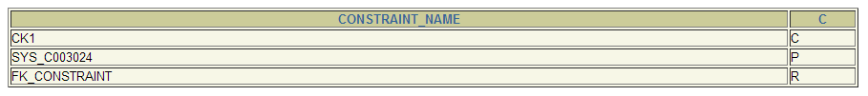
Cascading Constraint
CREATE TABLE test1 (
pk NUMBER(4) PRIMARY KEY,
fk NUMBER(4),
col1 NUMBER(4),
col2 VARCHAR2(4),
CONSTRAINT fk_constraint FOREIGN KEY(fk)
REFERENCES test1,
CONSTRAINT ck1 CHECK (pk > 0 and col1 > 0));
Table Created.
ALTER TABLE test1 DROP(pk);
ERROR at line 1:
ORA-12992: cannot drop parent key column

Slide 25
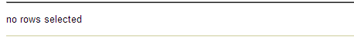
Cascading Constraint
ALTER TABLE test1
DROP(pk) CASCADE CONSTRAINTS;

Slide 26
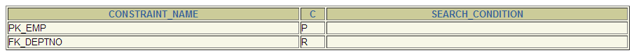
Viewing Constraint
Query the USER_CONSTRAINTS table to view all constraint definitions and names.
SELECT constraint_name, constraint_type,
search_condition
FROM user_constraints
WHERE table_name = ‘EMP’;

Slide 27
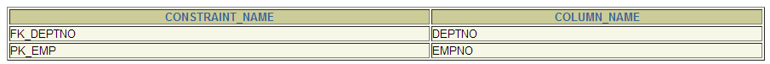
Viewing Constraint
View columns associated with the constraint names in the USER_CONS_COLUMNS view
SELECT constraint_name, column_name
FROM user_cons_columns
WHERE table_name = ‘EMP’;

Slide 28
SUMMARY
In this lesson, you should have learned how to create constraints.
Types of constraints:
  NOT NULL
  UNIQUE
  PRIMARY KEY
  FOREIGN KEY
  CHECK
You can query the USER_CONSTRAINTS table to view all constraint definitions and names.

Slide 29
FINAL EXERCISE
Login to your account
Create your own EMPLOYEE table
Create your own DEPARTMENT table
Add constraints to your tables
Add records to your DEPARTMENT table (at least 5 records)
Create a transaction script for inserting records for your EMPLOYEE table (at least 10 records)
Create a select statement that will logically join the two tables you created

